Slide 1
Go Kits
Dallas – KD9TJH

Slide 2
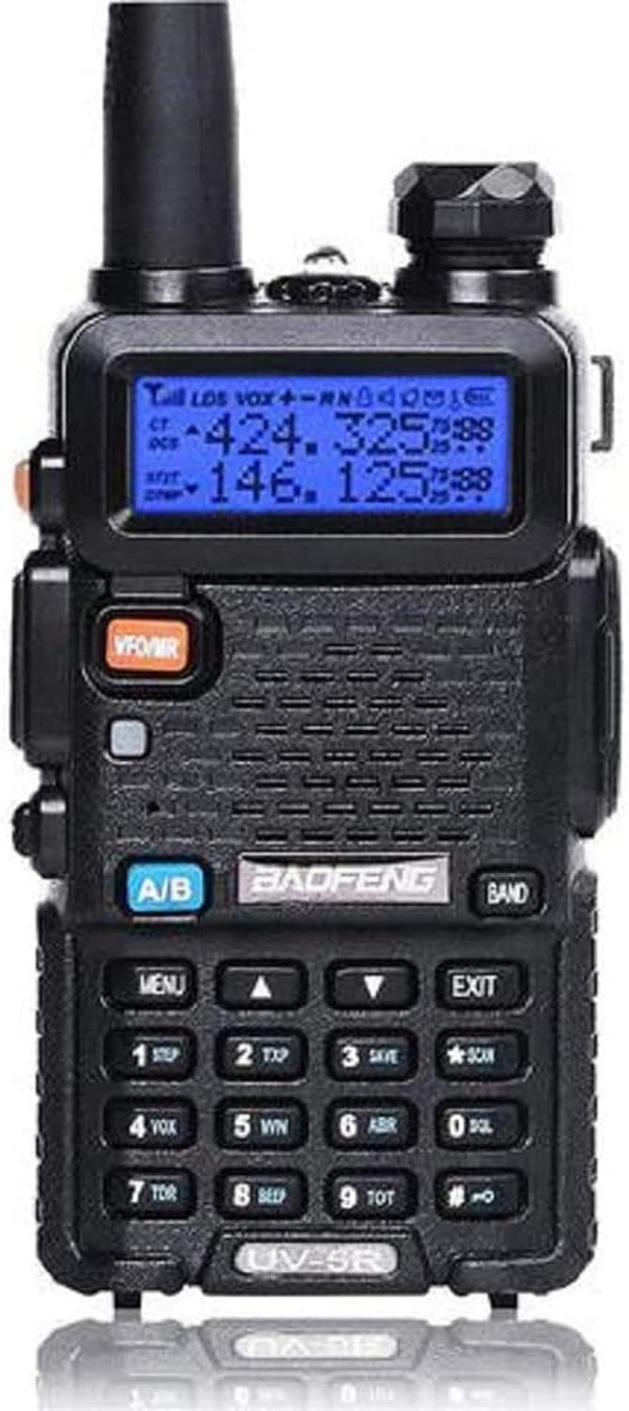
What is a Go Kit?
HT
UHF/VHF Radio
HF Radio
HF/VFH/UHF Radio

Slide 3
Why have a Go Kit?
Communicate with local hams
Pota
Sota
Emergency Communications

Slide 4
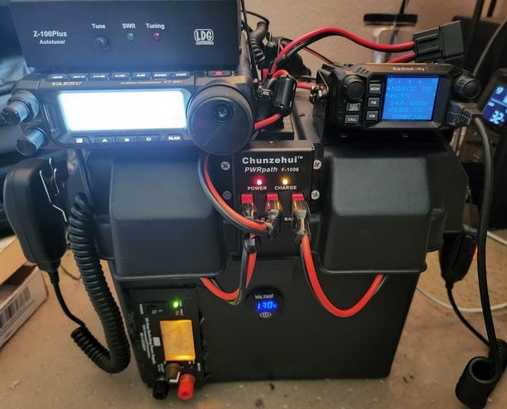
What to put in a go kit?
Radio
Tuner
Power Supply
Speakers/Headphones
Batteries
Lighting
Antennas
Coax Cables

Slide 5
Things to Consider
What do you plan to do
Talk Locally?
Hike?
Bike?
Contest?
Capabilities
Low powered/high powered
Portability
Size/weight

Slide 6
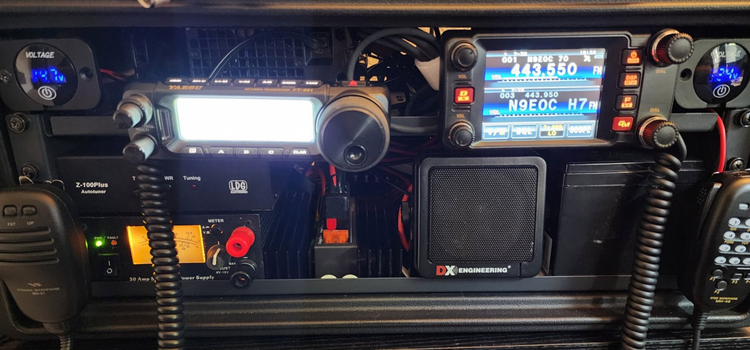
Why I built mine?
Field Day
Emergency Communications
1 kit, being base station and Go Kit
I wanted one kit to do everything.

Slide 7
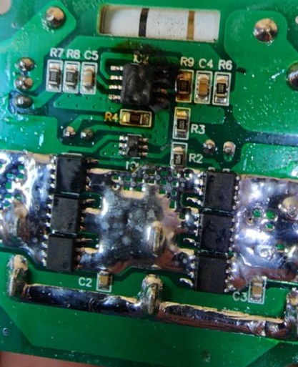
Lessons Learned
Batteries
My Station must be grounded for HF usage.
Use a quality power gate for Battery Control and Charging

Slide 8
Parts LIst
QiaoYoubang 5 Pack of 1U Vented Blank Panel - Steel Blank Rack Mount Panel Spacer for 19in Server Rack Cabinet or Enclosure, Black (1U) - 30.99
PL259 Jumper Cable, RG8x Jumper Cable 1ft, 2 Pack CB Antenna Coax Cable 12inch 50 ohm Low Loss for Ham Radio, Antenna Analyzer, Dummy Load and SWR Meter – 14.99 x2
Gator Rackworks Standard Size Rack Screws; 25 Pack (GRW-SCRW025) , Black – 7.99
JINGCHENGMEI 1U Disassembled Vented Cantilever Server Rack Mount Shelf 10"(254mm) Depth for 19-Inch Network/AV Equipment Rack and Cabinet(1U10V) – 19.59 x 2
Ancable 6ft 3.5mm Stereo Female to 2-Male Y-Splitter Audio Cable – 9.99
Upgraded 12V Voltage Gauge with Touch Switch Digital Display Volt Gauge, DC 12V 24V Car Voltmeter LED Digital Display Waterproof Voltmeter Panel for Boat Marine Vehicle Motorcycle Truck ATV UTV Car – 14.99 x2
XZNY 12V 18Ah LiFePO4 Battery, 5000+ Cycles Deep Cycle LiFePO4 Battery Built-in 20A BMS - $65
Chunzehui F-1011 6-Position 45A Power Pole Distribution Block Module, Connector Power Splitter Distributor Source Strip. – 32.99
West Mountain Radio Super PWRgate Battery Backup Systems PG40S – 139.95
DX Engineering DXE-281 Communications Speakers DXE-281 – 16.99
SKB 1SKB-R4S Roto-Molded Shallow 4U Rack Case – 209.99
MISC Wiring, Ferrites/Toroids
Parts cost $600 plus Radios, Power Supply and Tuner

Slide 9
Questions?

