Slide 1
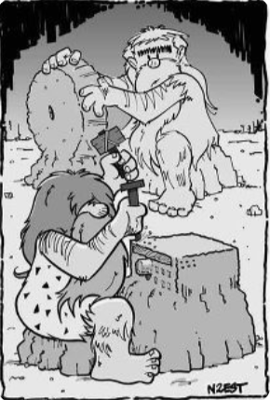
Amateur Radio High Frequency Communication
John gooldy, W9KD
January 26, 2023

Slide 2
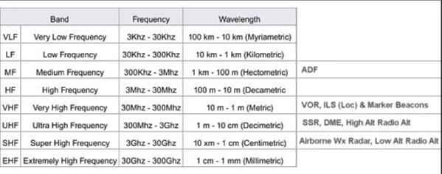
Hf cOMMUNICATION
Why is it called “High Frequency” when it is one of the lowest bands in ham radio? And why is it called “Short Wave” when the antennas are long?

Slide 3
High Frequency Communication
How is HF different than vhf/uhf?
What is there to do on hf?
What equipment does it take?
How much does it cost?
What do you need to know to pass the exam?
WebSDR

Slide 4
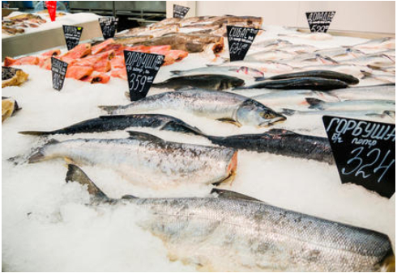
How HF is different than vhf/uhf “There’s something fishy about amateur radio”
VHF/UHF repeaters are like getting fish at the grocery store
Consistent conditions (Line of Sight)
Predicable outcome
Typically short local conversations
More like a function
HF is like going fishing
Variable conditions (Skywave Propagation)
Variable outcome
Talk all day/night if you like
World wide conversations
More like a sport

Slide 5
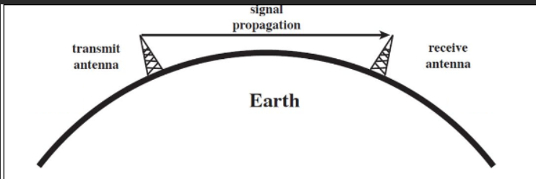
Line of sight propagation (VHF/UHF)

Slide 6
Skywave propagation (HF)

Slide 7
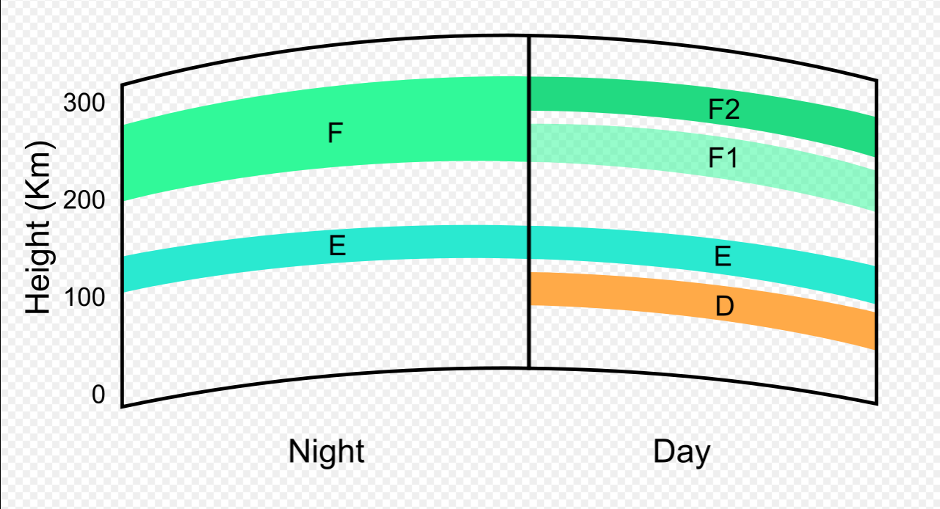
Ionosphere effect on hf Acts Like different sizes of screen mesh
As wavelength gets shorter, the signal goes up, until it no longer gets refracted and goes into space instead.
HF is refracted. VHF, UHF go to outer space
VHF/UHF Ducting: Temperature inversions. Extends range.
https://en.wikipedia.org/wiki/Ionosphere

Slide 8
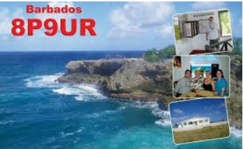
What is there to do on hf? Popular Activities
Rag chewing
Emergency Communications
Learn about technology
Nets
Operating awards
Special events
Contesting

Slide 9
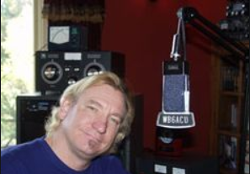
Rag chewing It’s like a box of chocolates You never know what you are going to get.
The “original” ham radio
Meet interesting people
Learn about living in other countries
Learn about interesting topics
Round tables
Short Wave Listening
No time limits
Avoid topics about religion or politics
Joe Walsh “The Eagles” WB6ACU

Slide 10
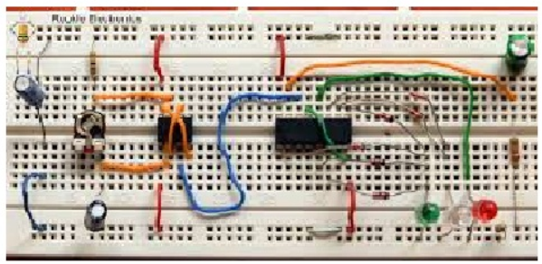
Learn about technology
Technical discussions
Experimentation
Radio phenomenon
Building things
Modes on HF: SSB, AM, CW, FT8, PSK, RTTY, Packet, SSTV, more
Learning CW (Continuous Wave) “Train your Brain”

Slide 11
Nets Most nets are listed with ARRL
Indiana Traffic Net
https://www.inarrl.org/index.php/public-service/indiana-nts
https://ylsystem.org (14.332 MHz)
Midwest Amateur Radio Service (MIDCARS), (EASTCARS)
Maritime Mobile Service Network
Professional Loafers Club
Hurricane Watch Net
http://www.nightwatchnet.net/
Mobile Emergency & County Hunters Net
Hundreds of nets ARRL has a list of several.

Slide 12
Special Events Special Event Station is a special operation usually in observation or commemoration of a special or historical event.
http://www.arrl.org/special_events/search/page:2/model:Event

Slide 13
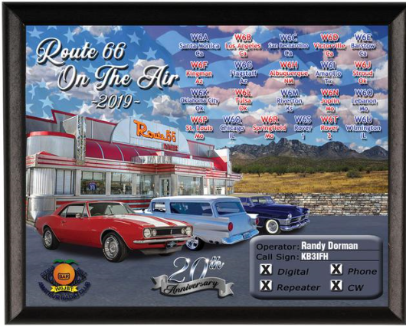

Slide 14
On the air programs

Slide 15
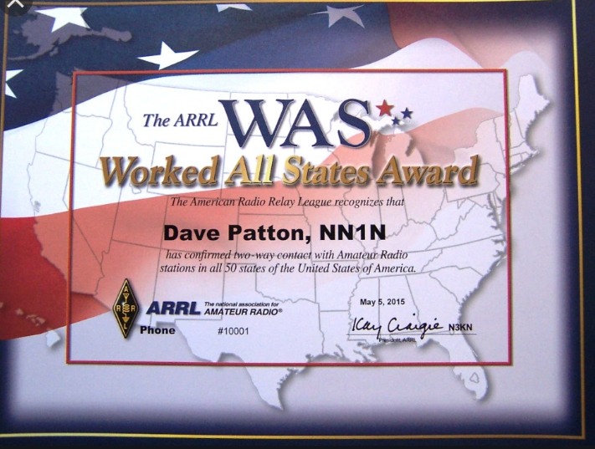
Operating awards

Slide 16
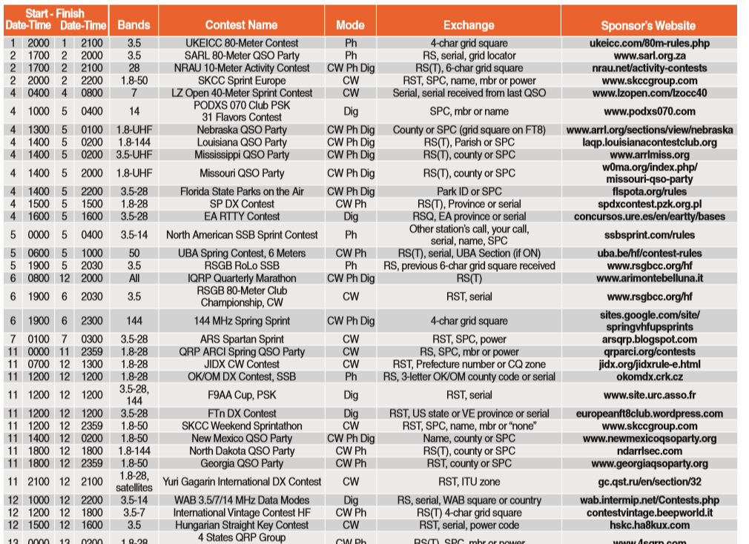
Contests

Slide 17
What equipment does it take?
HF radio, power supply (and computer if you want to do digital)
Feedline
Antenna (Piece of wire will do fine)
Impedance matching tuner (usually, but not always, needed)
Watt/SWR meter
Somewhere to put an antenna
Tree, tower, attic, ground mount, creative (i.e. flag pole)
HOA’s and antennas

Slide 18
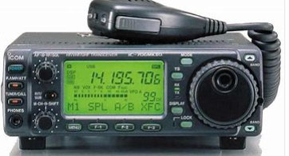
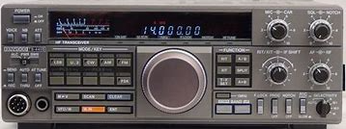
How much does it cost?
Good used HF radios start around $350
Used power supply apx. $75
Antenna, feedline, connectors, rope $30-$150
Good used tuner <$100
Good used Watt/SWR meter <$40
$500 - $700 total
Icom IC-706
Kenwood TS-440sAT

Slide 19
What you need to know to pass exam
Safety practices
Rules and regulations
HF band plan
Proper operational practices
Very basic electronics
Don’t worry. We can help you with electronic knowledge.
No complex math needed
Study guides available
Free online practice test exams

Slide 20
Web sdr

Slide 21
www.Websdr.org worldwide network of radio receivers

Slide 22
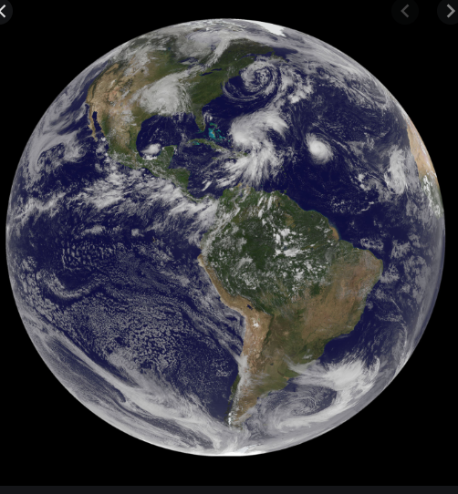
The world is yours on hf!
Always someone to talk with
Everyone is equal
Expands your mind globally
Doesn’t have to cost a lot

Slide 23
Useful web sites
www.arrl.org
http://www.arrl.org/on-the-air
www.arrl.org/arrl-magazines
www.websdr.org
www.qrz.com
https://ksarrl.org/deeplink/
https://www.contestcalendar.com/weeklycont.php

Slide 24
Questions ?
w9kd@aol.com John Gooldy

